Slide 1
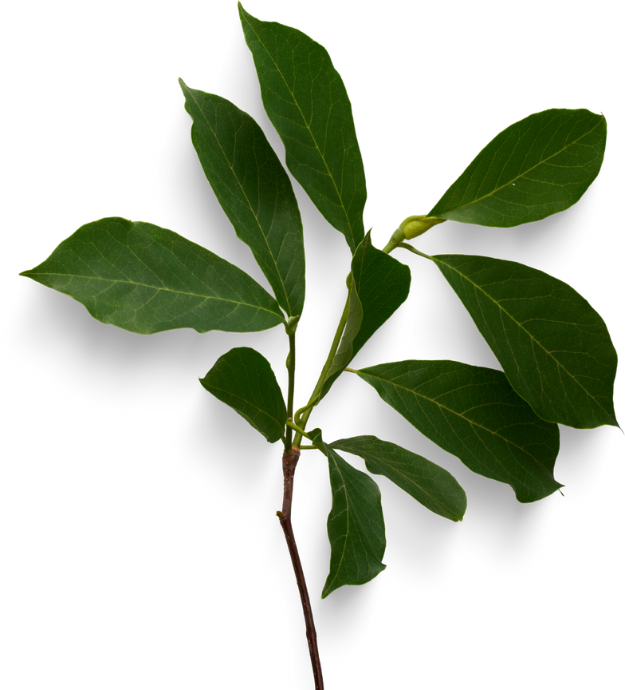
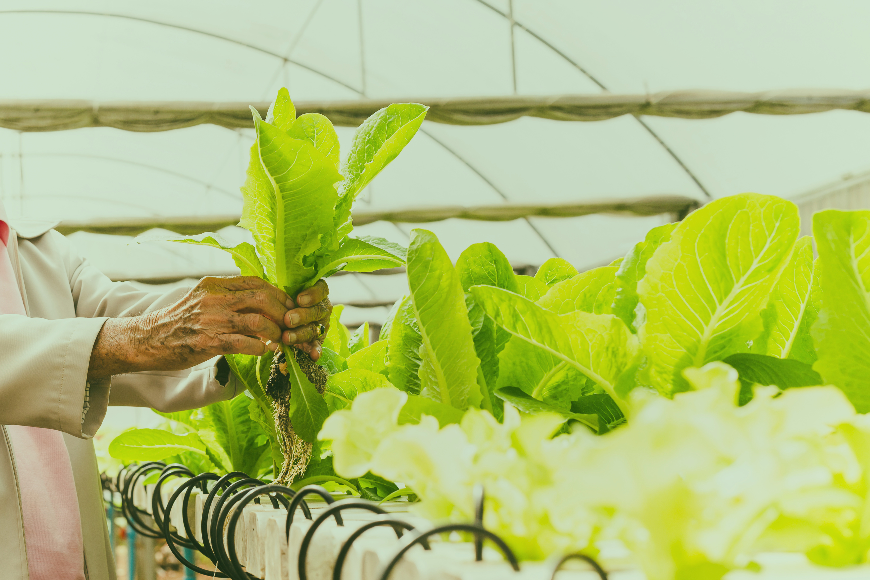



FRADEL AND SPIES
SMART GARDEN
REPORT PRESENTATION

Slide 2
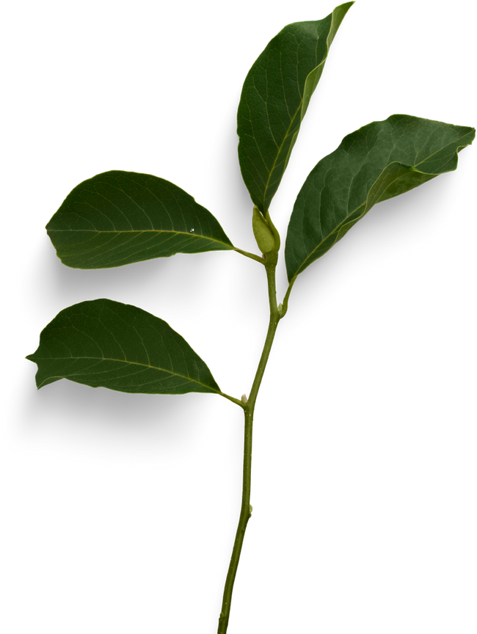

FRADEL AND SPIES
MEET ME
MUHD AZRUL

Slide 3

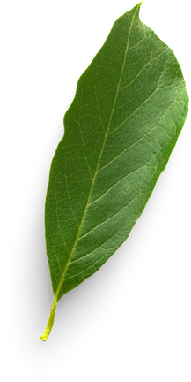
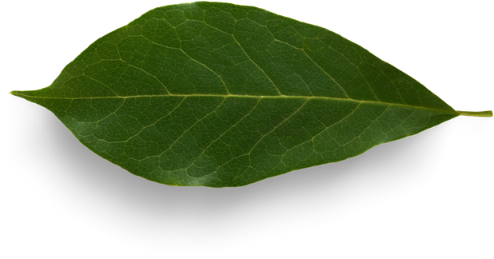
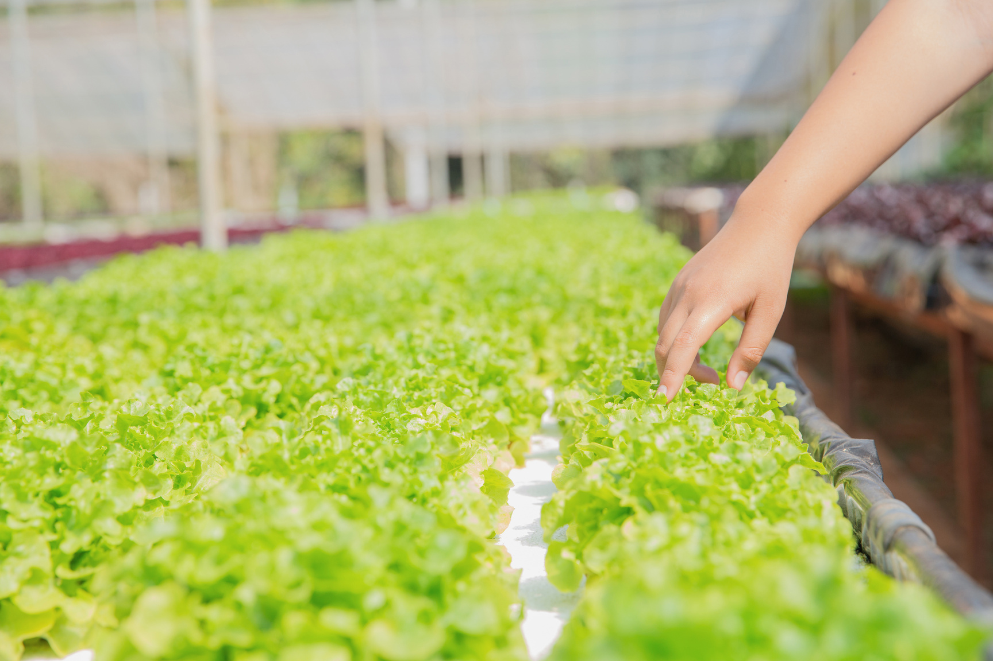
FRADEL AND SPIES
INTRODUCTION
The Smart Garden Monitoring System automates garden maintenance by using sensors to track important factors like soil pH, light, water levels, temperature, and CO2 concentration. It provides real-time data and automates irrigation to ensure plants get the right care with less effort.
This system helps gardeners and small farms save resources, reduce costs, and improve plant growth. It’s a sustainable solution that supports urban gardening and food production, making it easier to manage gardens efficiently.

Slide 4
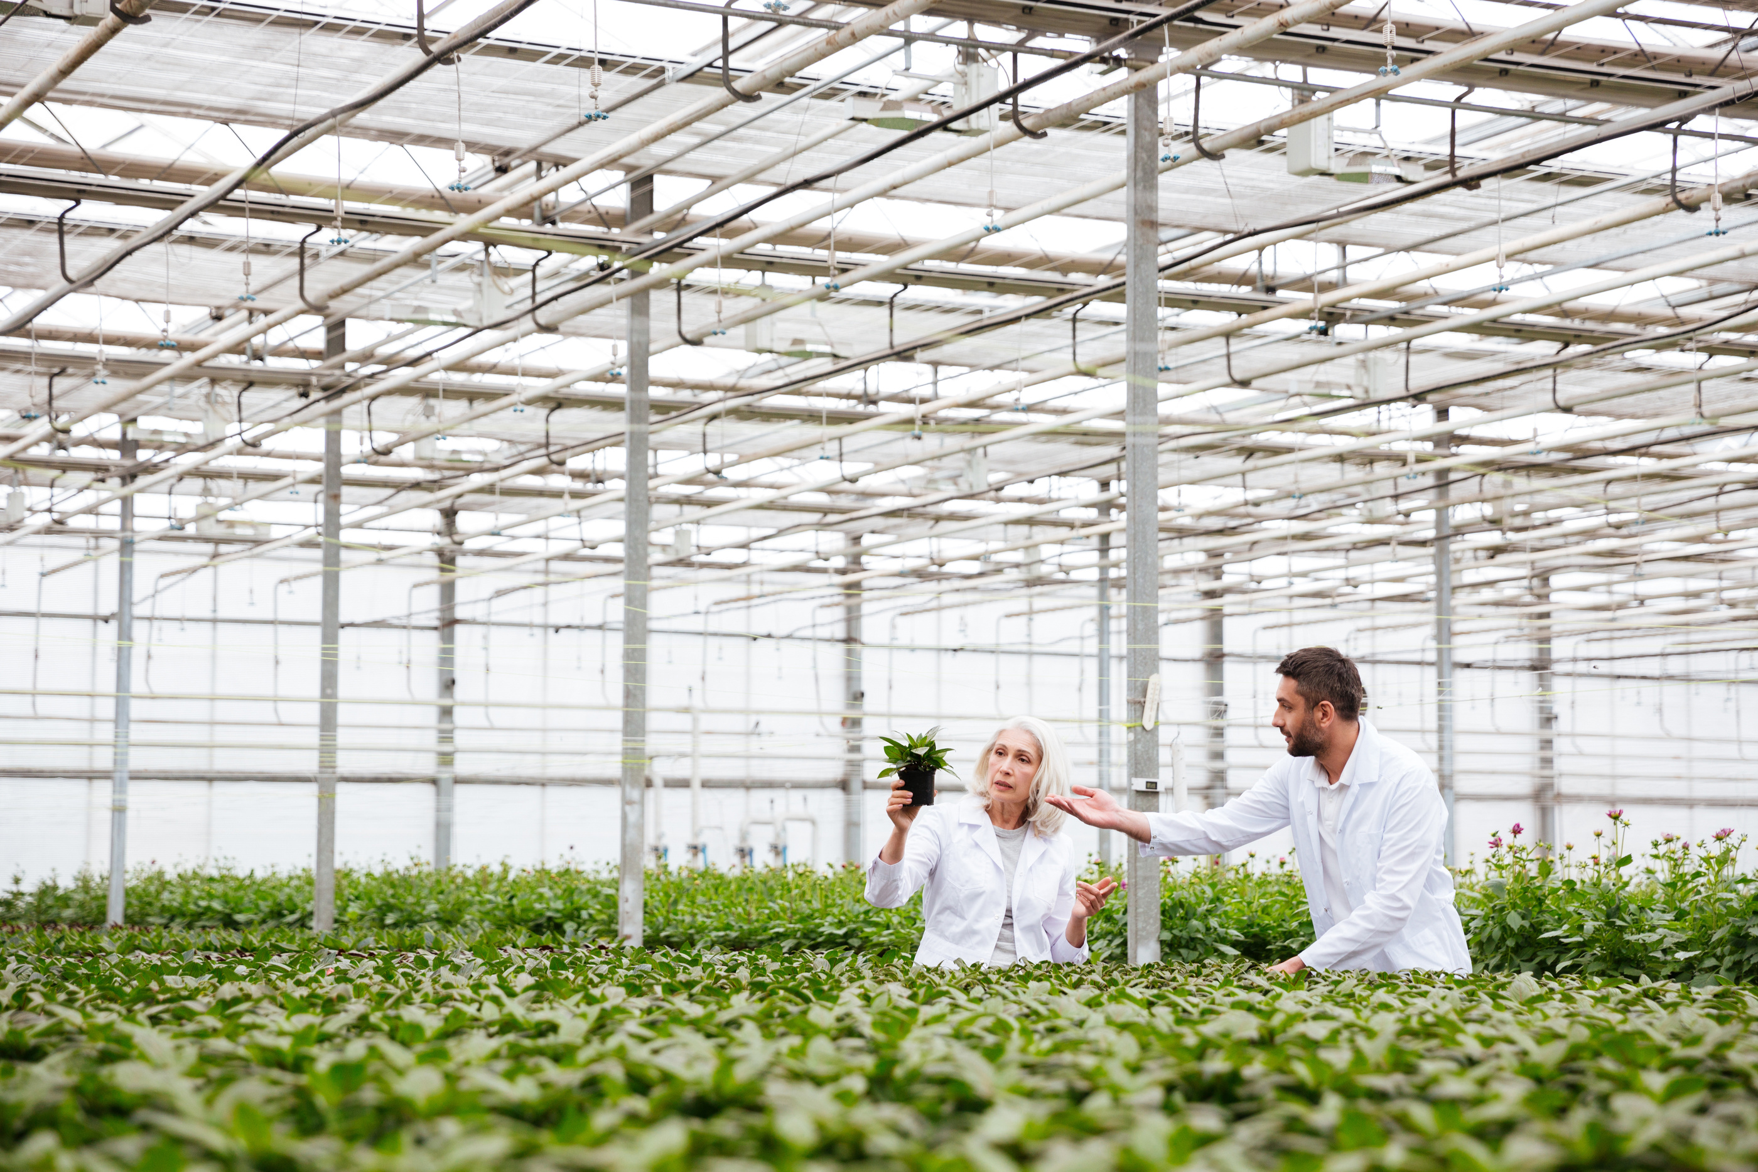
PROBLEMS AND SOLUTIONS
Inconsistent Irrigation:
Problem: Plants get too much or too little water, causing stress.
Solution: Use automatic irrigation with sensors to water plants only when needed.
Wrong Soil pH:
Problem: If the soil pH is off, plants can’t absorb nutrients properly.
Solution: Install pH sensors to keep the soil at the right level for plant growth.
Not Enough Light:
Problem: Without enough light, plants can’t grow well.
Solution: Use light sensors to track light levels and adjust artificial lighting when needed.
Temperature Swings:
Problem: Extreme temperatures can harm plants.
Solution: Use temperature sensors to control heaters or fans and maintain a stable environment.
Poor Air Quality (High CO2):
Problem: High CO2 levels can affect plant respiration.
Solution: Install CO2 sensors to monitor and improve air quality.

Slide 5
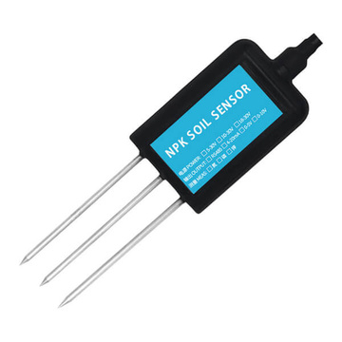
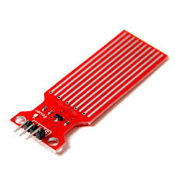
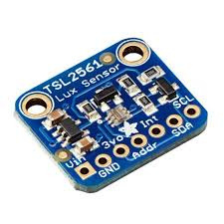
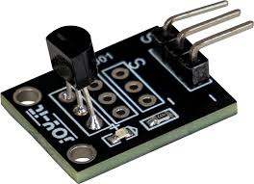
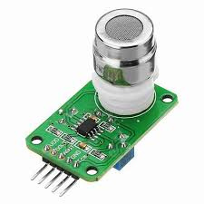
TYPE SENSOR USED
Water Level Sensor
Lux Sensor
pH Sensor
Temperature Sensor
Co2 Sensor

Slide 6
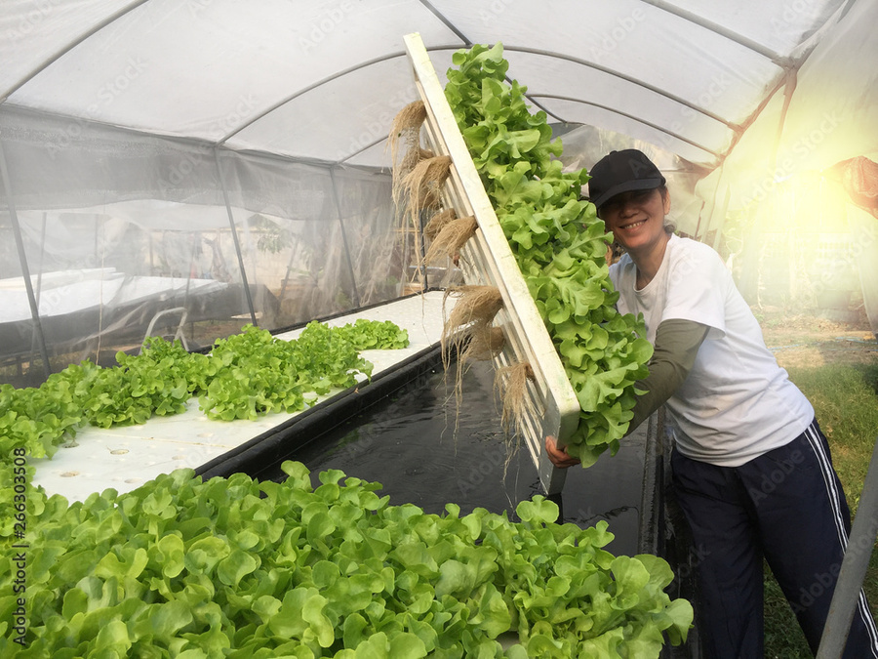
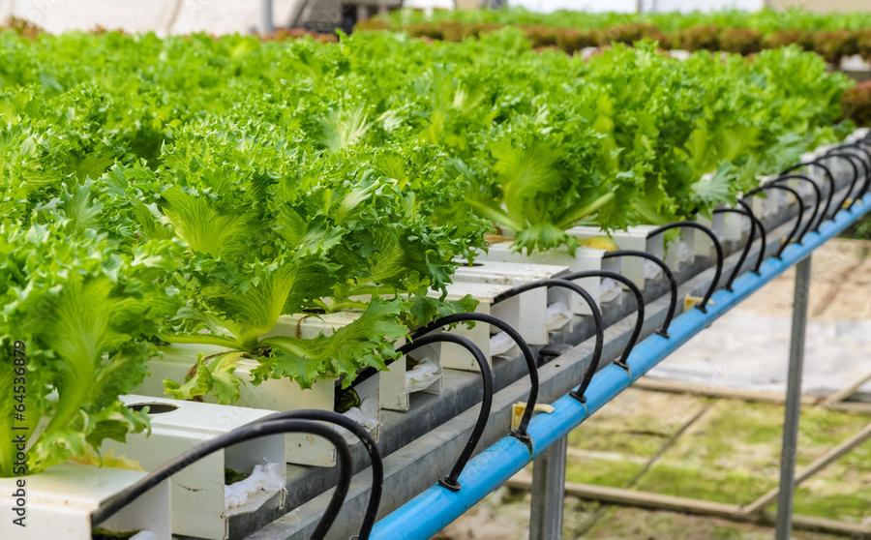
WHY THESE SENSOR CHOSEN
Each sensor is chosen to meet essential gardening needs:
The pH sensor ensures the soil is balanced for nutrient absorption.
The lux sensor monitors light levels to support photosynthesis.
The temperature and CO2 sensors track the environment to promote healthy plant growth.
The water level sensor controls irrigation, preventing overwatering or dehydration.
Together, these sensors help maintain the ideal conditions for plants to thrive.
ROLE OF SENSOR
The sensors are the core of the system, collecting real-time data to maintain ideal plant conditions:
The pH sensor ensures the soil is balanced for growth.
The lux sensor keeps track of light exposure.
The temperature sensor monitors environmental changes.
The CO2 sensor ensures the air is right for photosynthesis.
Together, these sensors create a sustainable, automated gardening system.

Slide 7
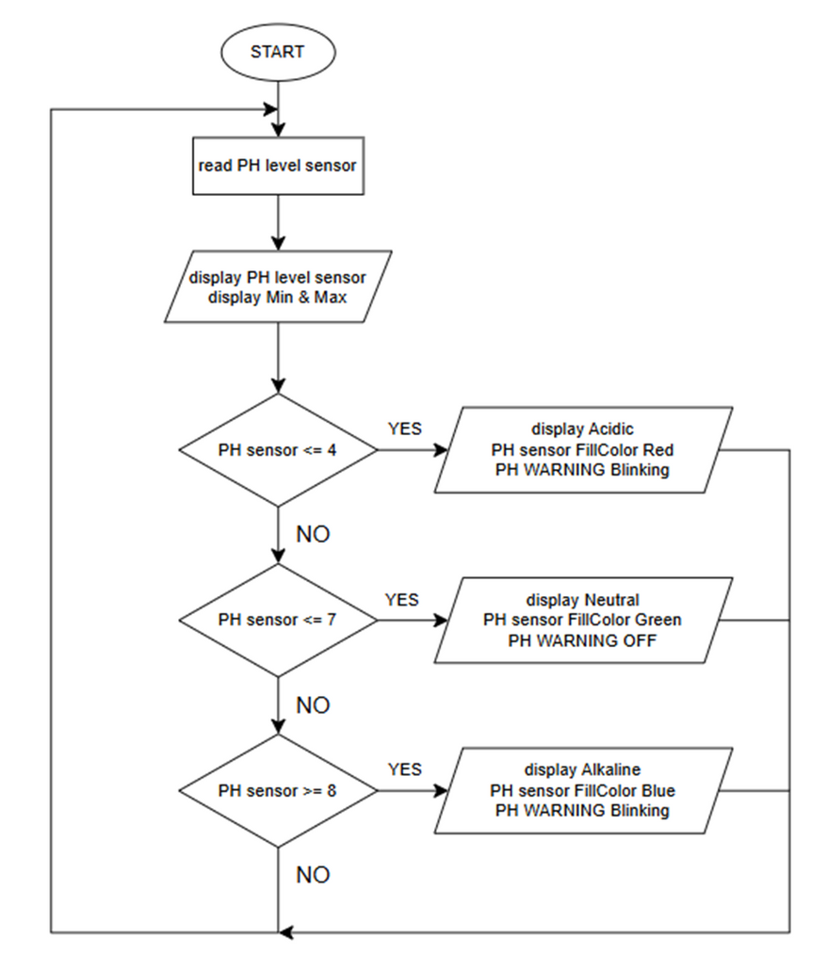
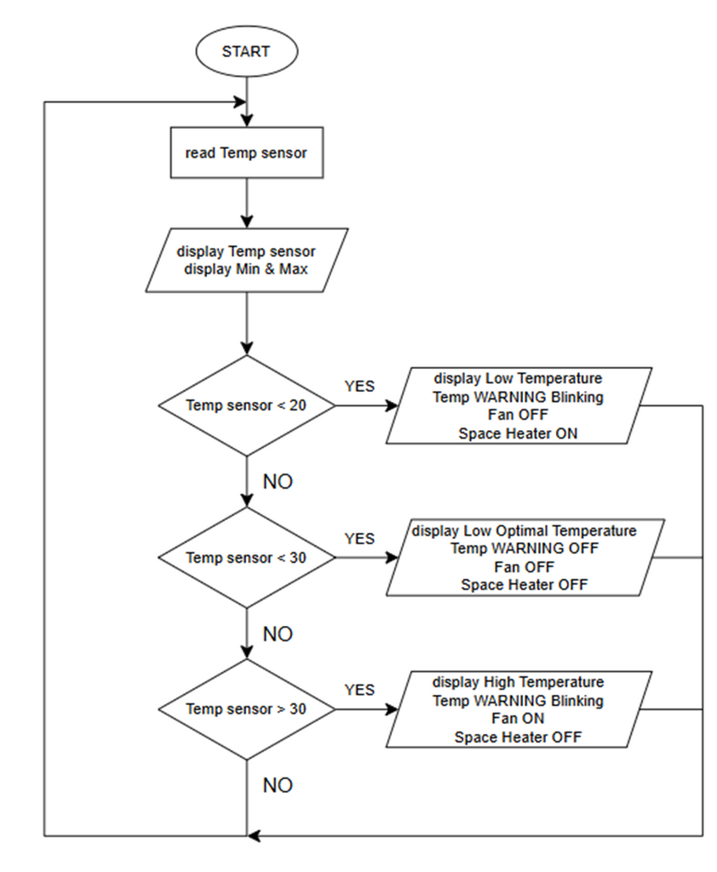
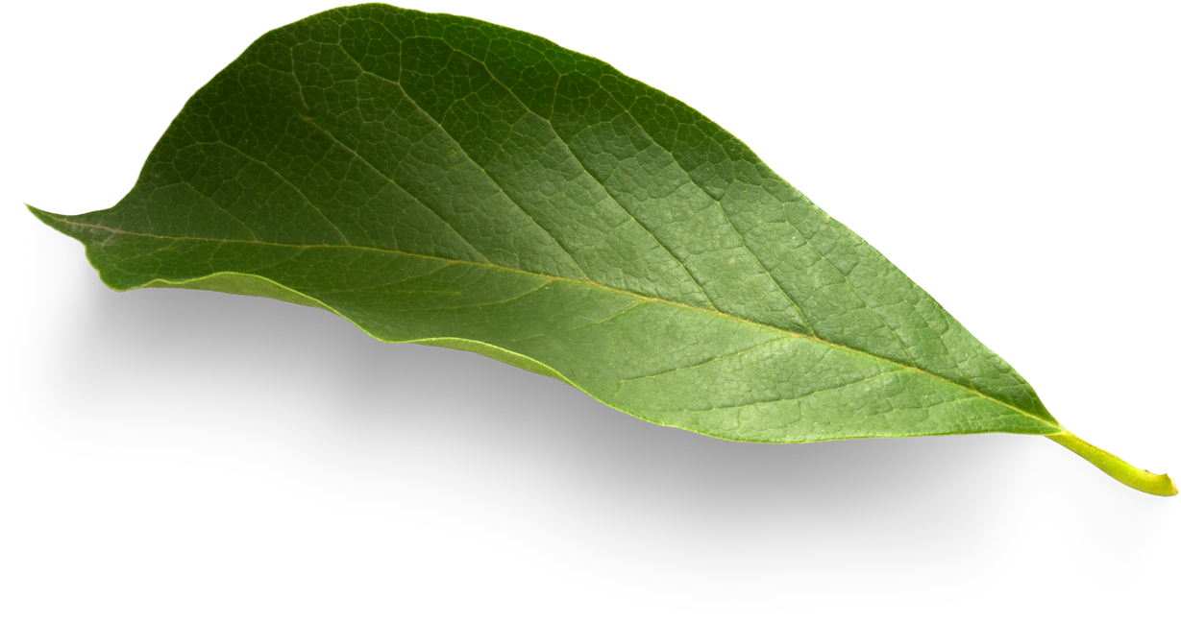
METHODOLOGY
FLOWCHART
Flowchart for pH sensor
Flowchart for Temperature sensor

Slide 8
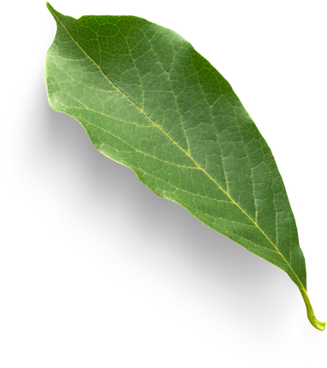
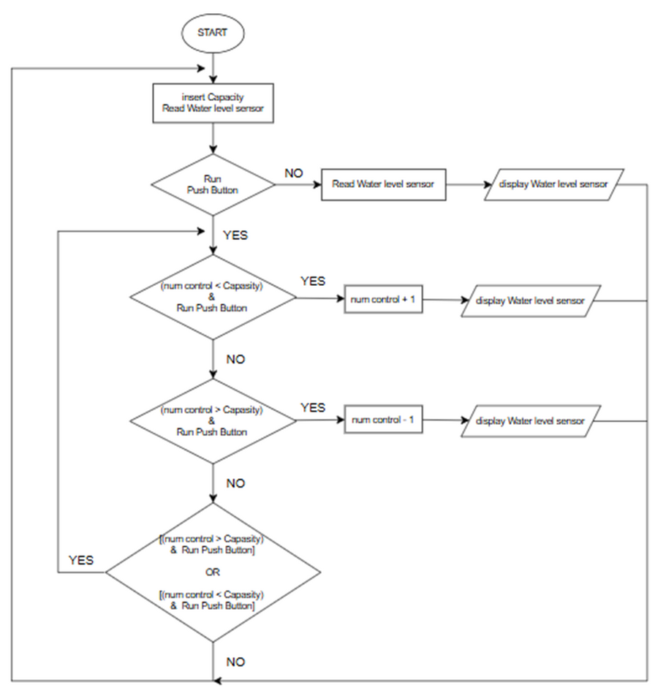
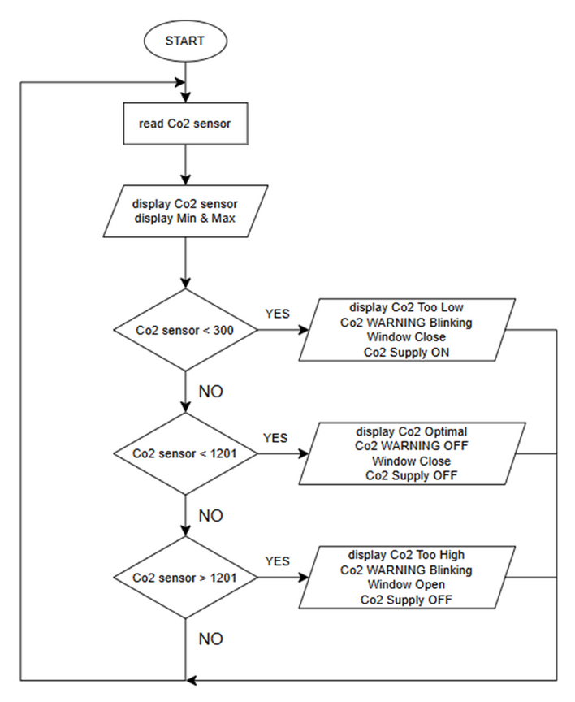
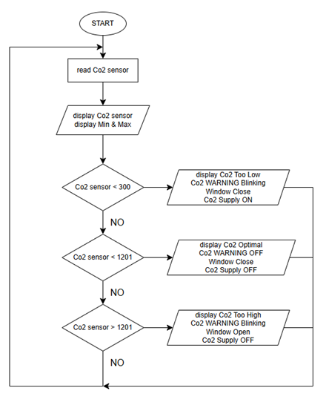

Flowchart for Water level sensor
Flowchart for Co2 sensor

Slide 9

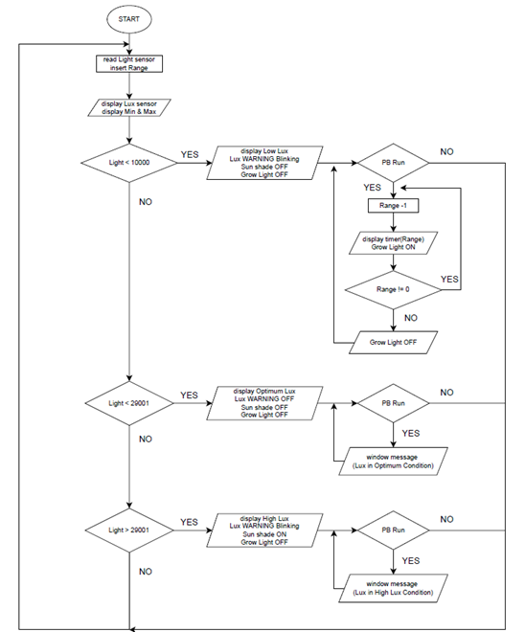
Flowchart for Lux sensor

Slide 10
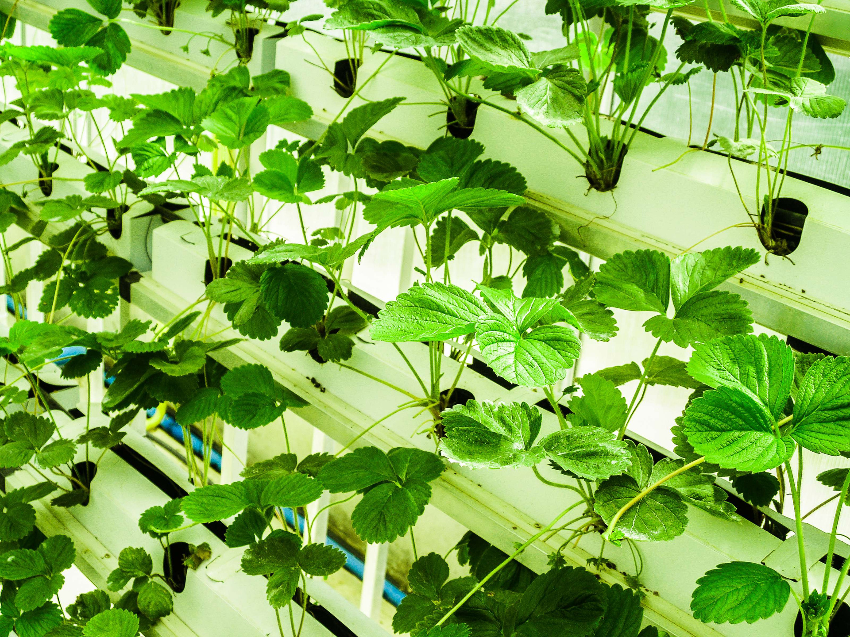
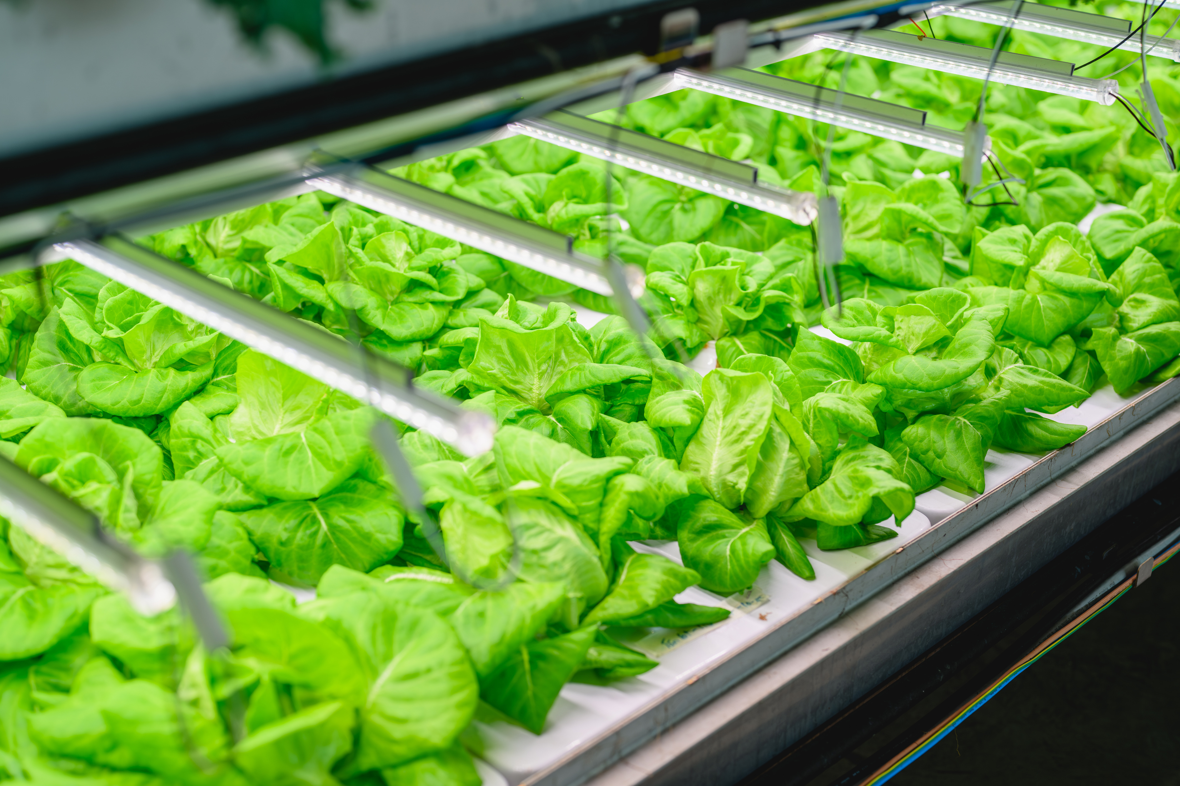
DISCUSSION
Automation and real-time monitoring make plant care more efficient. The system creates the perfect environment for plant growth with minimal user involvement. Automatic irrigation saves water and ensures plants get the right amount of moisture. Future improvements could include predictive analytics to anticipate plant needs and wireless control for remote access. However, challenges like sensor calibration, power stability, and environmental changes need to be addressed for long-term reliability.

Slide 11
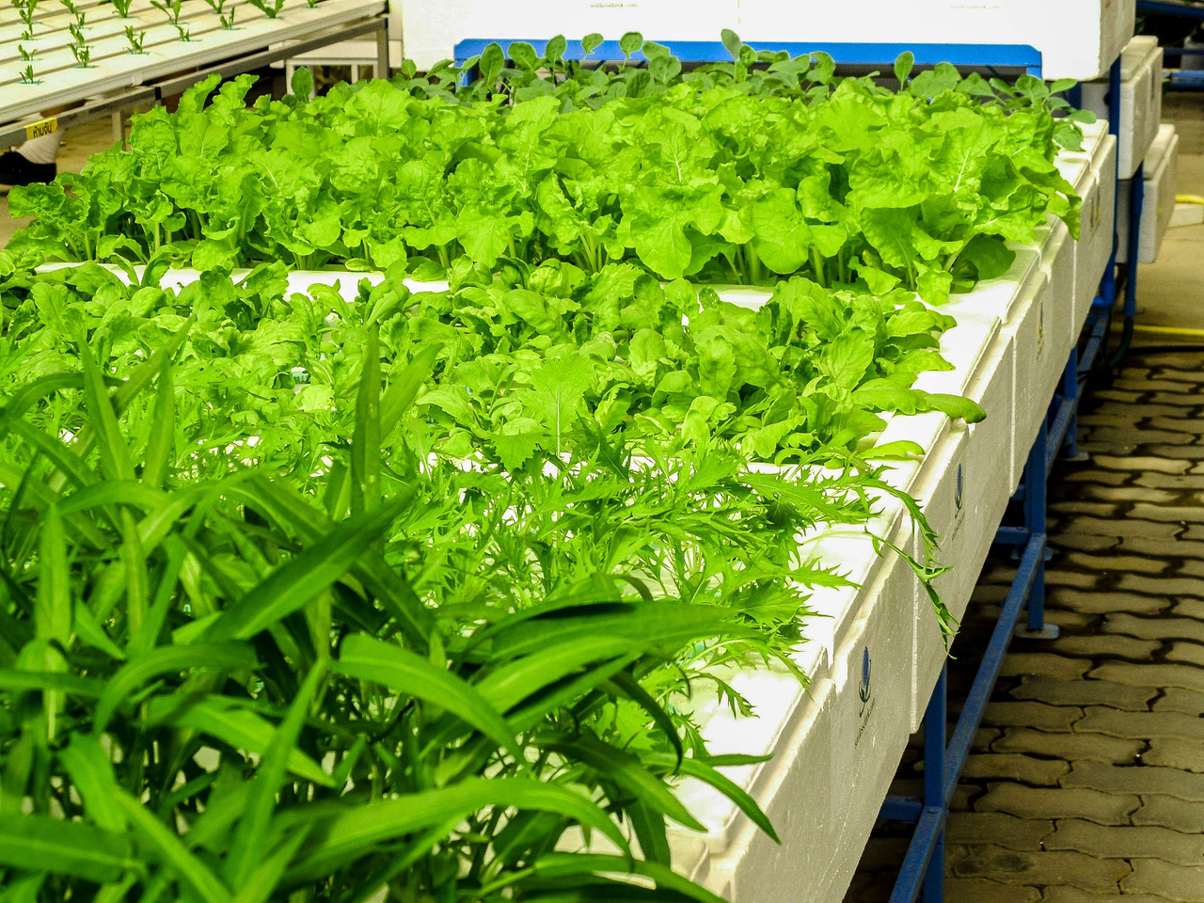

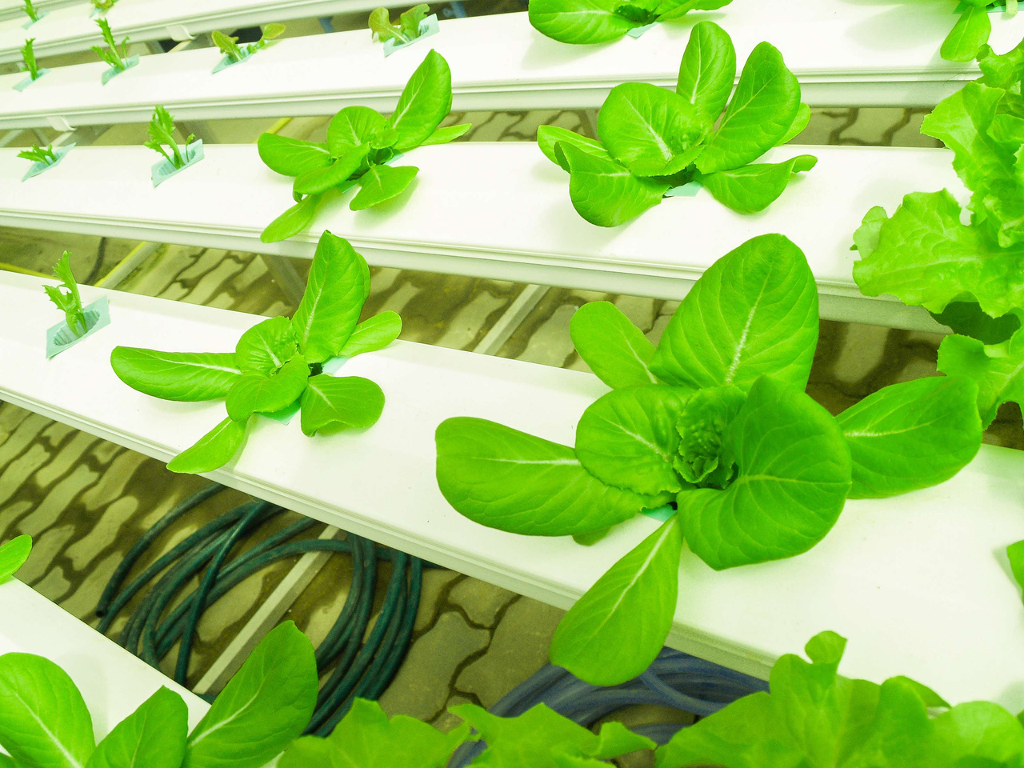
SALFORD & CO.
CONCLUSION
The Smart Garden Monitoring System offers a practical and efficient solution for maintaining healthy gardens. The technology improves plant growth while lowering labor costs by using sensors for automated control and real-time monitoring. This research raises up opportunities for advancements in sustainable agriculture by showcasing the potential of smart gardening.

Slide 12
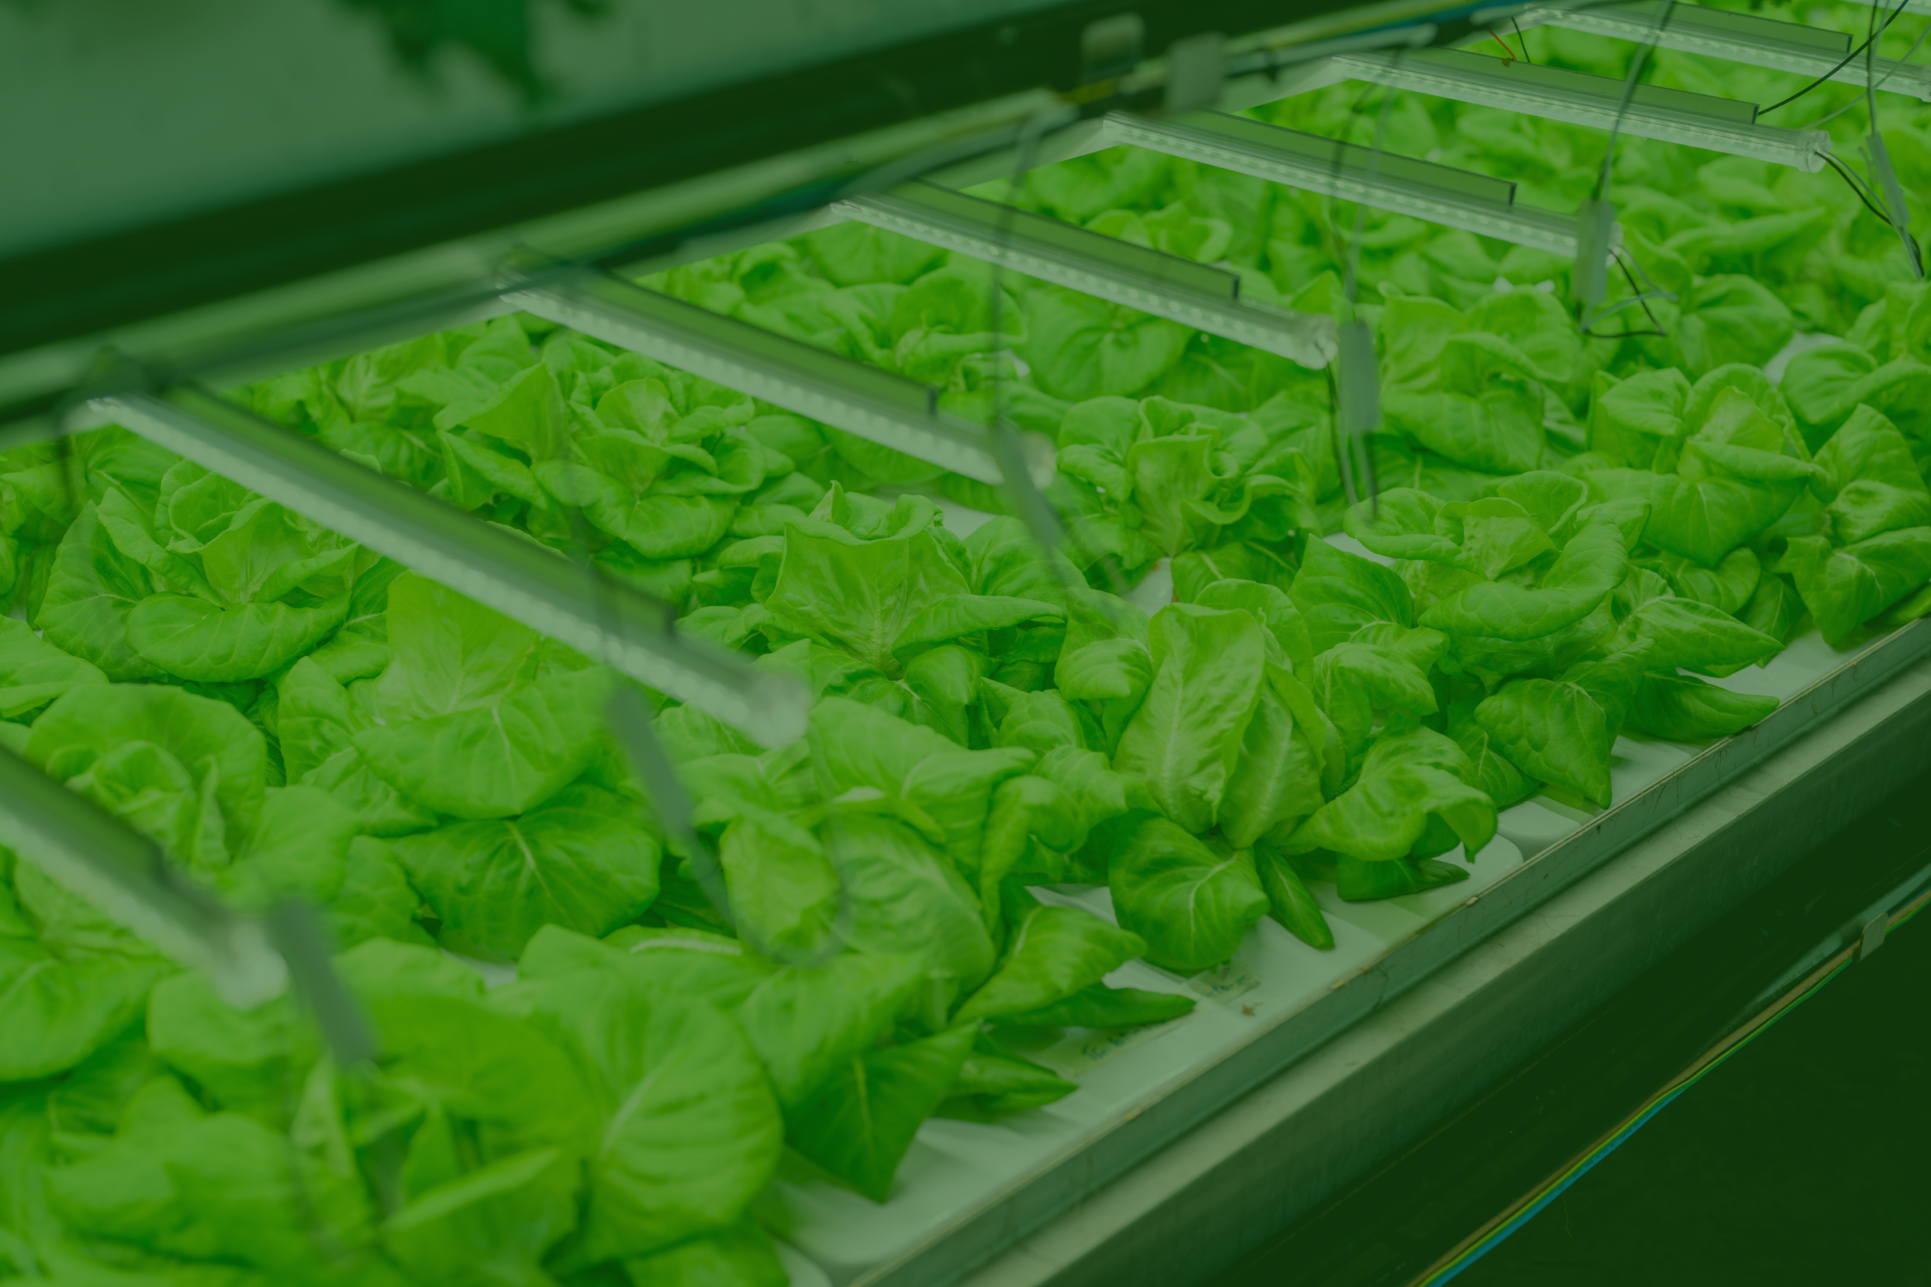
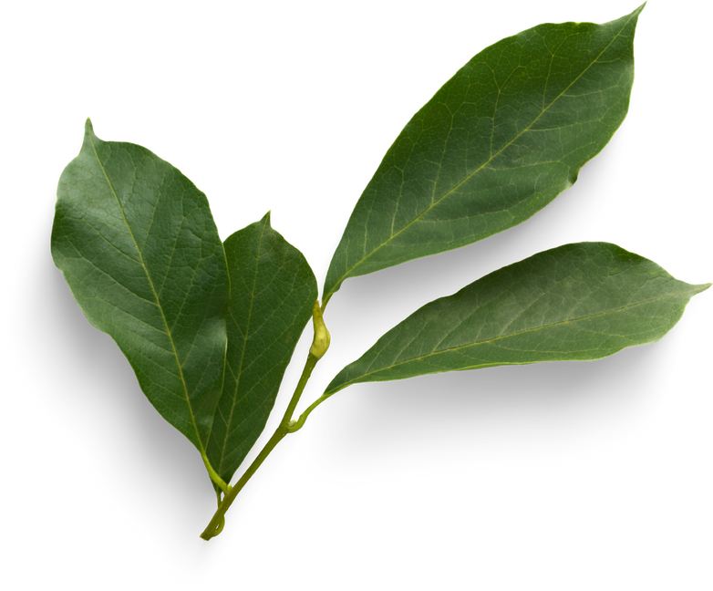
THANK YOU

